Slide 1

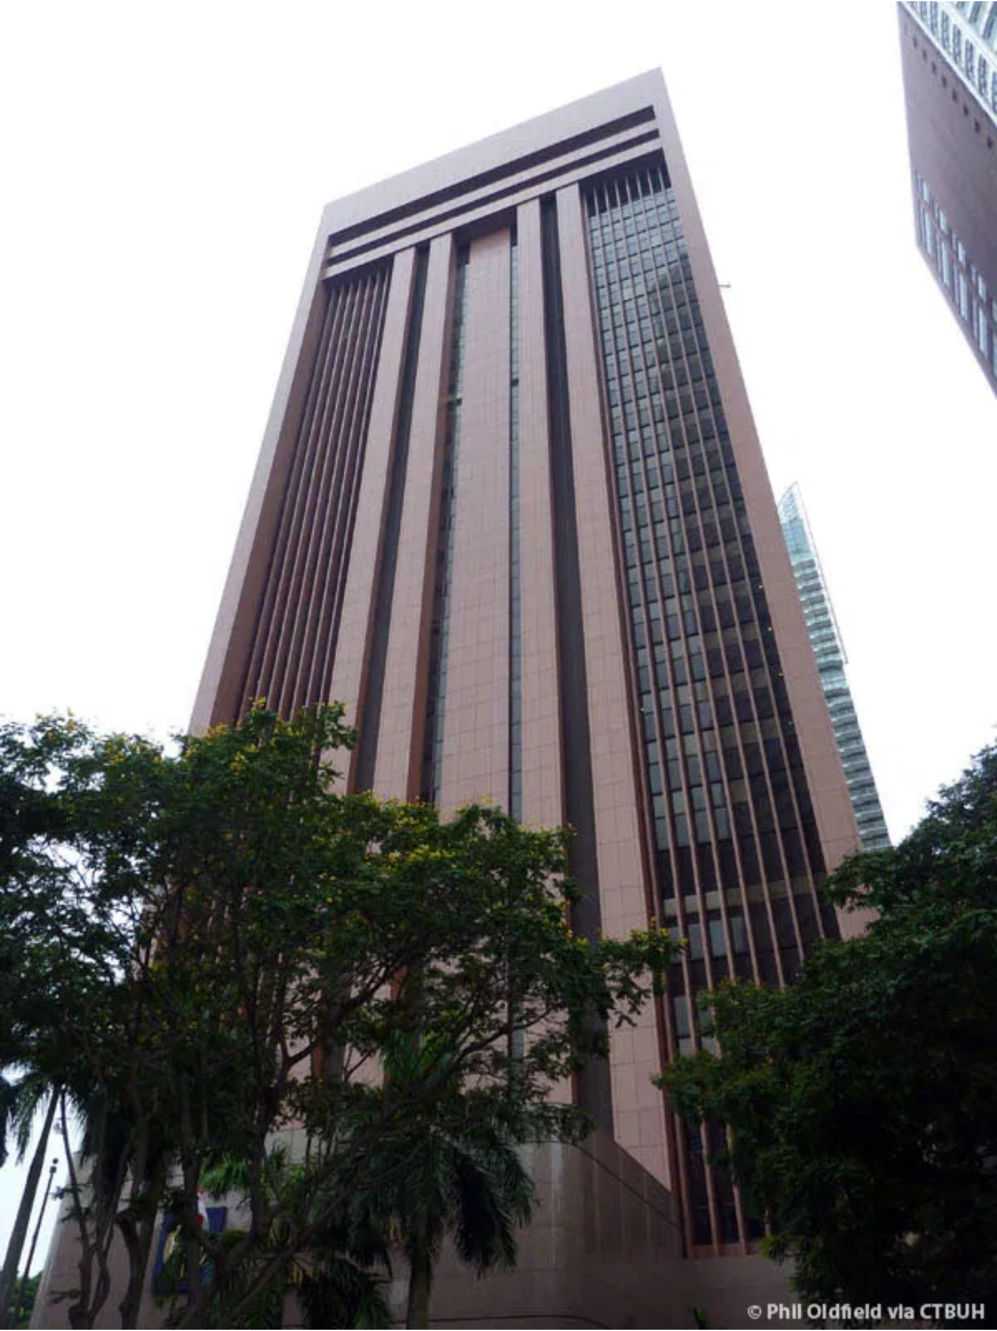
Introduction to Singapore's Monetary Policy
Singapore's monetary policy is unique, focusing on
managing the
exchange rate
rather than traditional interest
rates.
The
Monetary Authority of Singapore (MAS)
, acts as the
central bank, ensuring price stability for sustainable
economic growth.
This approach is tailored to Singapore's small, open, and trade-reliant economy, where the exchange rate has a more significant impact on inflation.

Slide 2

Why Exchange Rate Instead of Interest Rates?
Singapore is a
small and highly open economy
, where trade
plays a dominant role.
Gross exports and imports of goods and services are
more
than 300% of its GDP
, and domestic expenditure has a high
import content.
In such an economy, the
exchange rate has a much stronger
influence on inflation
than domestic interest rates.
For example, an appreciation of the Singapore dollar reduces the cost of imported goods, thereby dampening inflation.

Slide 3
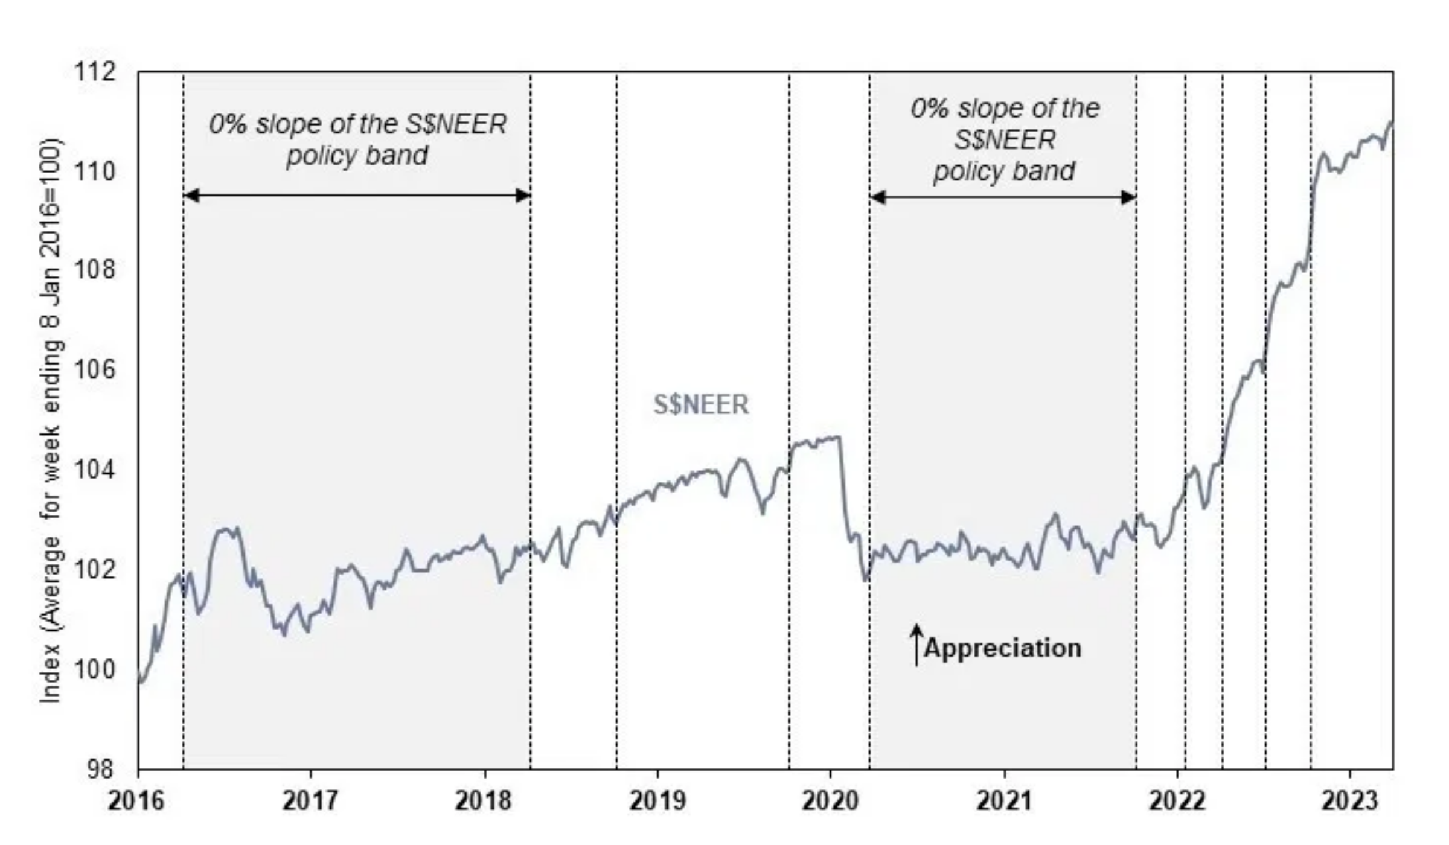
The S$NEER Policy Framework
The
Singapore Dollar Nominal Effective Exchange Rate
(S$NEER)
is a combined index of bilateral exchange rates.
It represents the Singapore dollar against a
trade-weighted
basket of currencies
of its major trading partners.
Weights are assigned based on the
importance of trade
relationships
with each country.
This allows the Singapore dollar to perform collectively in
relation to its major trading partners, which is crucial for
general price levels
in Singapore.

Slide 4
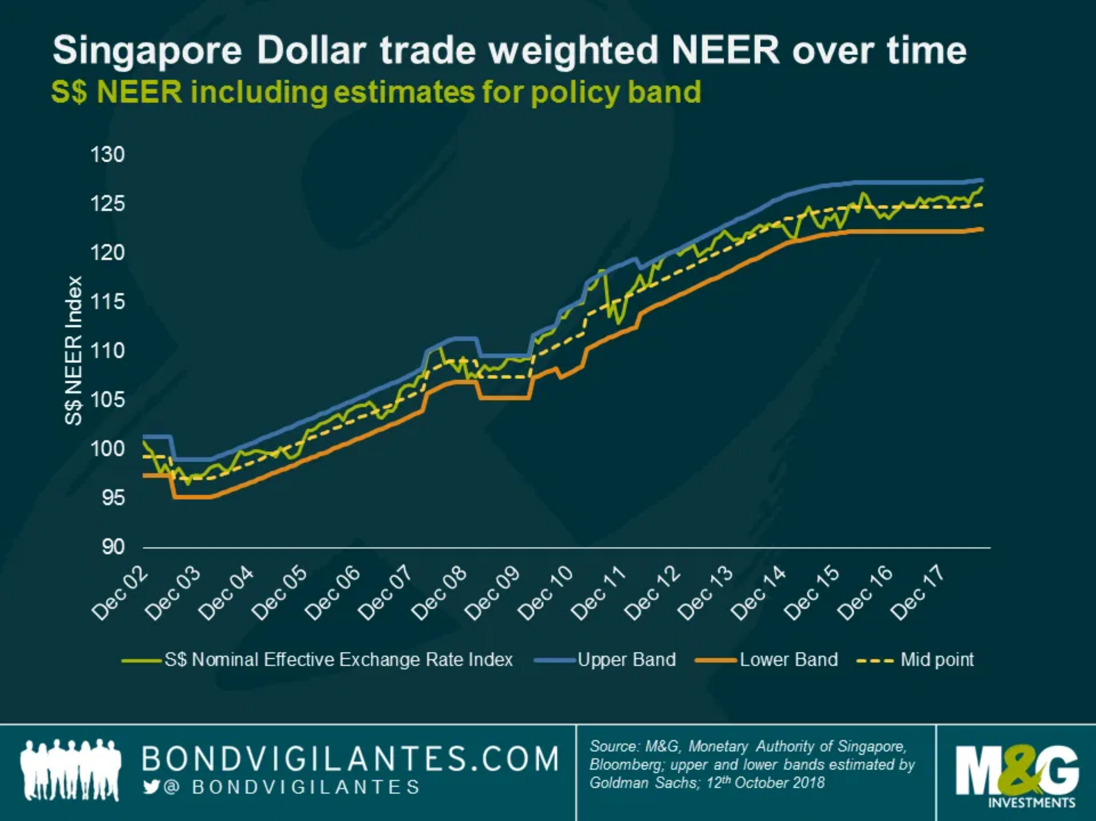
The Policy Band Mechanism
MAS does not set a precise level for the exchange rate.
Instead, the S$NEER is allowed to move within a
policy band
.
The exact levels of this policy band are
not disclosed
to the
public.
If the S$NEER moves
outside this band
, MAS intervenes by
buying or selling Singapore dollars.
This intervention ensures the S$NEER remains within the
desired range, maintaining
price stability
.

Slide 5

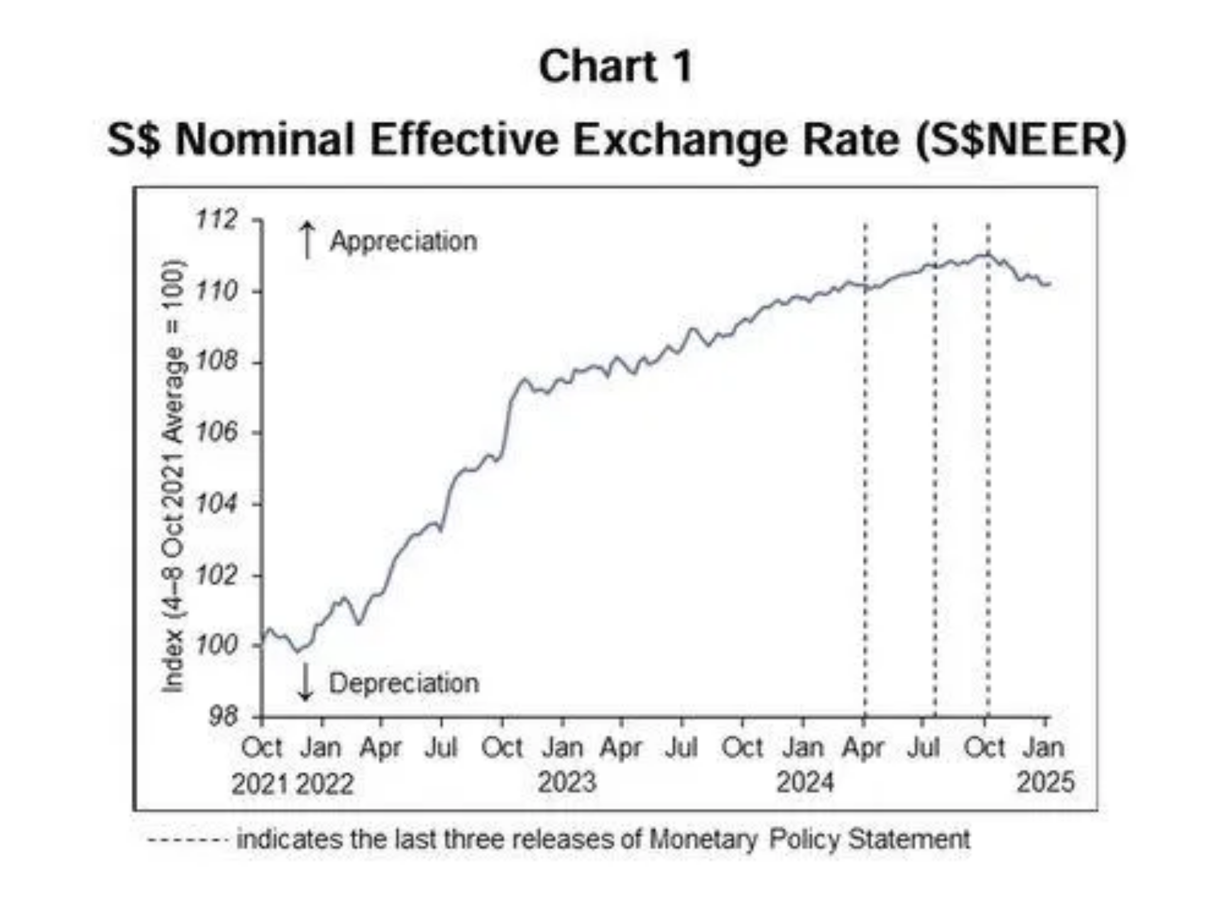
Three Policy Levers
MAS adjusts three key parameters of the S$NEER policy band:
: Influences the pace at which the Singapore dollar strengthens or weakens.
The
Slope
: Allows for an immediate strengthening or weakening of the S$NEER, used in drastic situations like a recession.
The
Level (Mid-point)
The
Width
: Determines the allowable volatility of the S$NEER.
These parameters are reviewed at least
twice a year
, typically
in April and October, with additional reviews if conditions
demand immediate change.

Slide 6
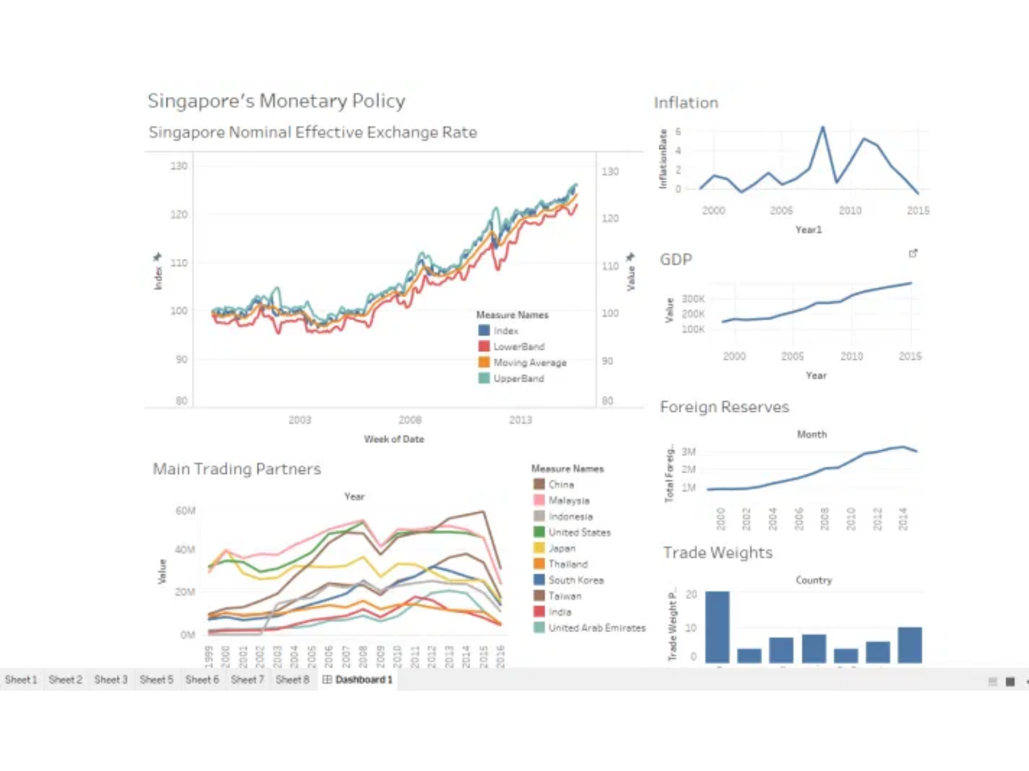
Policy Implementation
MAS implements its monetary policy primarily through
intervention operations
in the spot foreign exchange (FX)
market.
This involves the
sale or purchase of US dollars against the
Singapore dollar
, as the S$-US$ pair is the most liquid.
These operations directly influence the S$NEER to keep it within the policy band.
The policy parameters are reviewed at least
twice a year
(typically April and October), with additional reviews possible
if economic conditions warrant immediate changes.

Slide 7
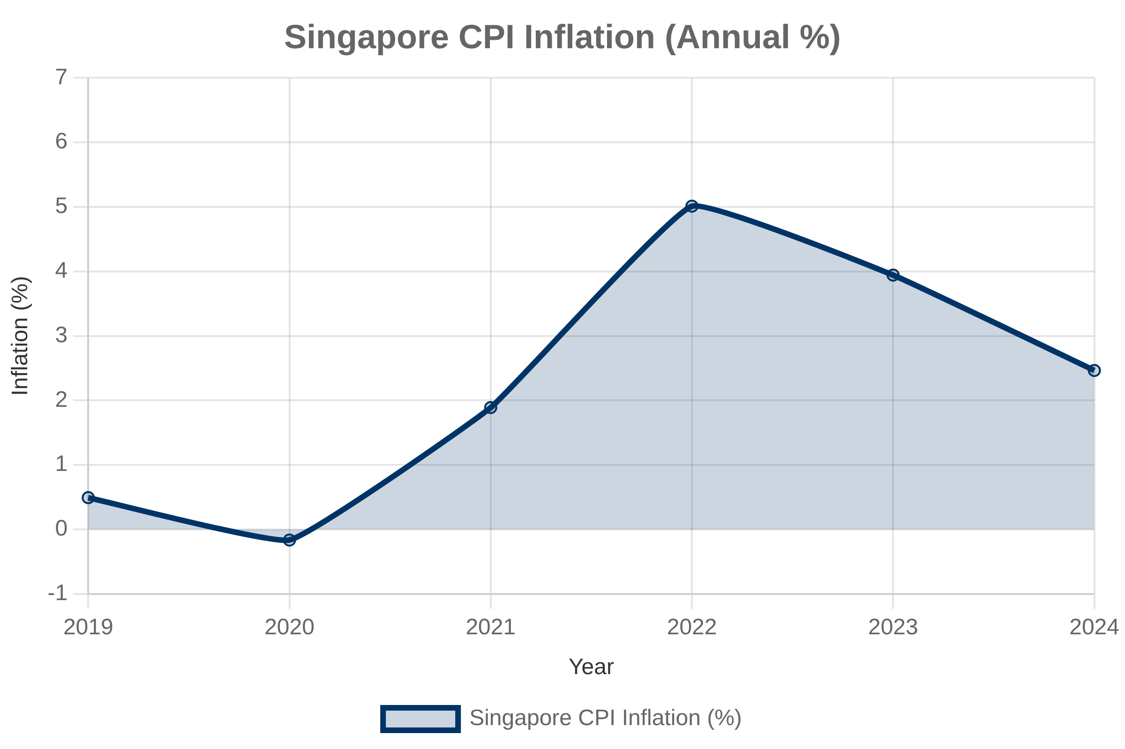
Effectiveness in Controlling Inflation
Singapore's exchange rate-centered monetary policy has
been highly effective in
maintaining price stability
.
By managing the S$NEER, MAS directly influences the cost of imports, which are a significant component of domestic consumption and production.
This approach has allowed Singapore to achieve
low and
stable inflation rates
over the long term, even amidst global
economic fluctuations.
International Monetary Fund (IMF) studies have consistently affirmed the effectiveness of this unique framework in delivering domestic price stability.

Slide 8

Advantages and Disadvantages
Advantages
Disadvantages
Effective Inflation Control
: Direct impact on import prices, crucial for a trade-dependent economy.
Limited Interest Rate Control
: Domestic interest rates are largely determined by global markets.
Price Stability
: Has consistently delivered low and stable inflation rates.
Export Competitiveness
: A stronger currency can make exports more expensive, potentially impacting competitiveness.
Supports Sustainable Growth
: Provides a stable economic environment for businesses.
Less Direct Control over Domestic Demand
: Focus on exchange rate means less direct influence on domestic spending.

Slide 9
Conclusion
Singapore's monetary policy stands out globally due to its
exchange rate-centered approach
.
The
S$NEER policy band
, managed by MAS, is the primary tool for maintaining price stability in a highly open economy.
This unique framework, with its three adjustable levers (slope, level, and width), has proven
highly effective in controlling inflation
and fostering sustainable economic growth.
While it differs from traditional interest rate policies, it is well-suited to Singapore's economic structure and has consistently delivered its objectives.

